Slide 1
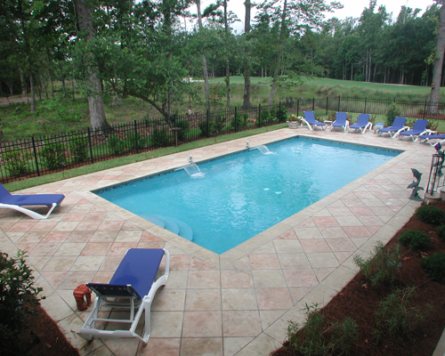

Pool Safety System
Ben Gilboa
CS231A Winter 2018, Stanford University

Slide 2
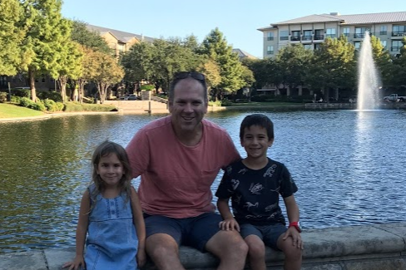
About Me
Name: Ben Gilboa
Born: 1978 (Israel)
Live: Dallas Texas
Married +2 kids
Education: BSc EE, MBA
Company: Texas Instruments
Organization: Wireless Connectivity
Position: Marketing product manager
First class under SCPD program
AI and CV rookie

Slide 3
Problem Statement
Back yard pool can be dangerous especially when toddler live in the house. Pool safety system can monitor the pool and provide real time notification in case of hazard
It can also notify when some maintenance is required
Main events that such a system can detect:
Kid fall into the pool
Animal fall into the pool (might drown and get stuck in the skimmer)
Pool is full of leaves (during foliage season it can overload the pump)
Low water level

Slide 4
Project Objective
Explore CV methods to design a pool safety system
Design basic 3 phases pipeline that can decide if a certain object in inside or outside a pool
Identify the pool boundaries
Run standard pre-trained object detection algorithm
Decision criteria for each detected object
Consider the performance of each phase in the pipeline and think about ways for future improvement

Slide 5
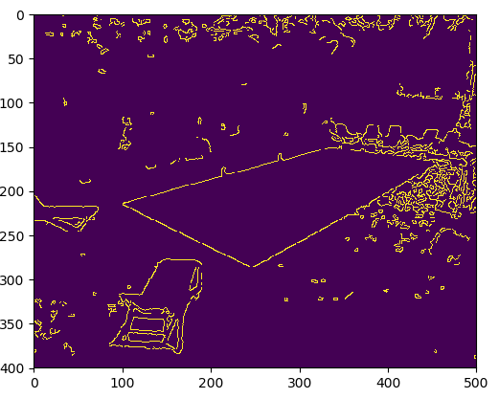
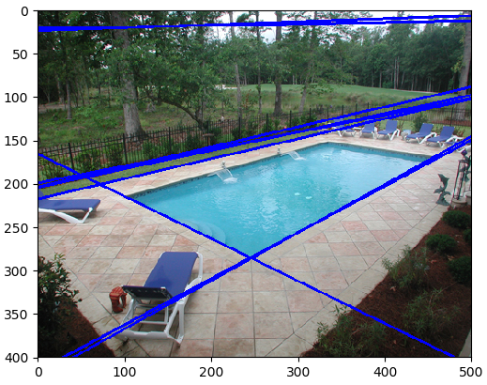
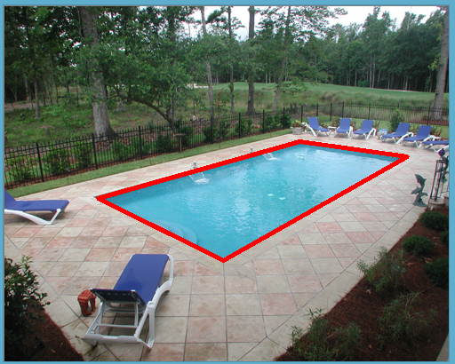
Phase 1: Pool Detection
Investigated several ways to detect the pool boundaries:
Canny edge detection and Hough transform
Segmentation by K-mean and mean shift
The method that gave best results is based on color range (shades of blue) and OpenCV functions for polygon detection and approximation

Slide 6
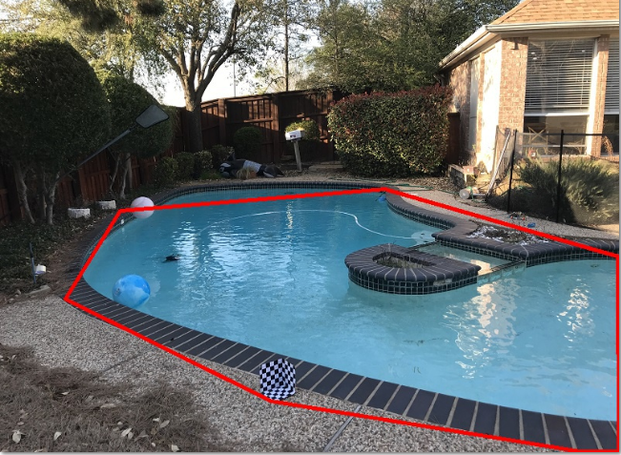
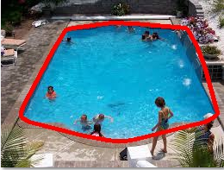
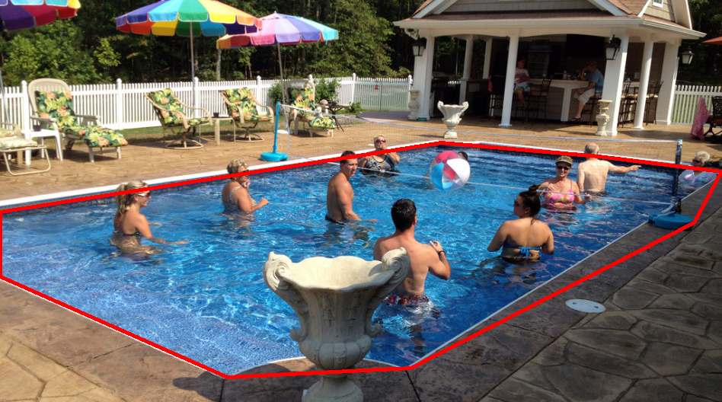
Phase 1: Pool Detection Cont’
The chosen algorithm provides good results for empty rectangular pools and other straight lines construction
Pool with curves or with objects that occlude the boundary are more difficult to detect and the algorithm needs to be improved

Slide 7
Phase 1: Pool Detection Cont’
Pool detection algorithm
Convert to HSV
Define blue shades boundaries in HSV (60,50,50) to (130, 255, 255)
Use threshold to mark image areas in blue range and out of blue range
Find all contours in the image using OpenCV find contours
Find largest contour
Apply convex hull to include occlusions

Slide 8
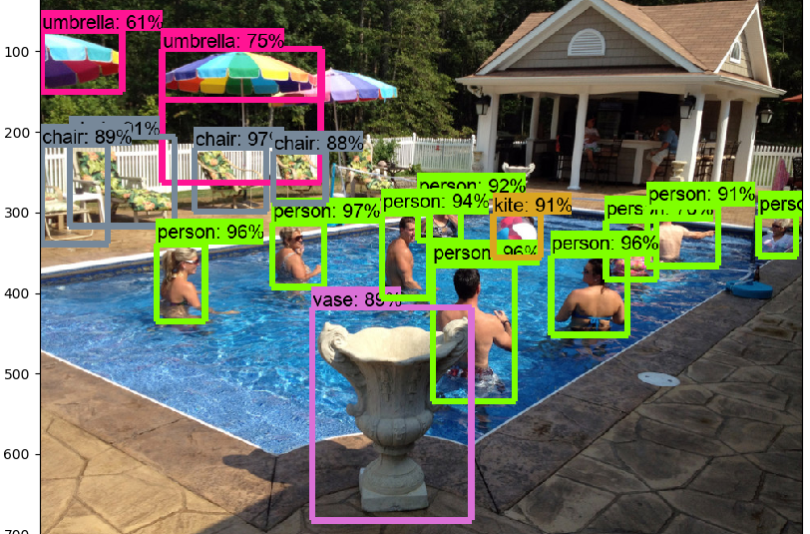
Phase 2: Object Detection
Used pre-trained CNN algorithm using Google TensorFlow
Struggled through the TensorFlow and the TesnorFlow Object detection API installation
Tested several pre-trained models to find a model that provides good performance vs run-time tradeoff
faster_rcnn_inception_resnet_v2_atrous_coco_2018_01_28 model gave the best tradeoff and I chose it for this project

Slide 9
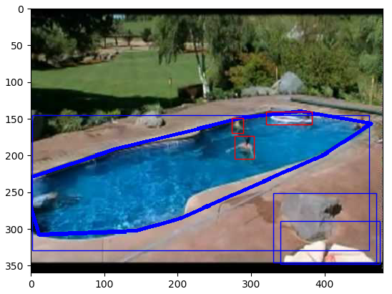
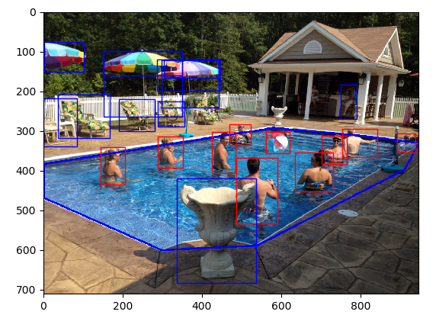
Phase 3: Decision
Decision algorithm to determine if a detected object is inside or outside the pool
Comparing the location of the bounding box detected in phase 2 and the polygon detected in phase 1
Decision criteria: check if bottom corners of bounding box inside the polygon
Red bounding box – inside
Blue bounding box - outside

Slide 10
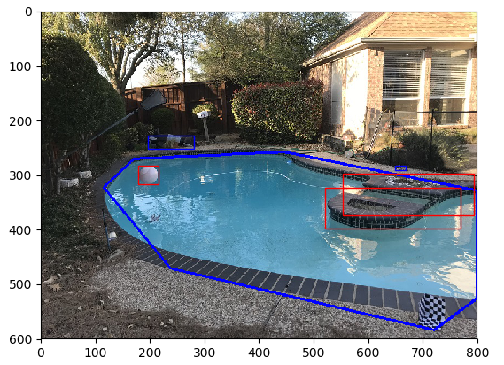
Further Challenges
Improve pool boundary detection algorithm. Combine segmentation methods and other way of feature extraction to detect pool in all kind of shapes in more reliable way
Improve scene recognition for better decision criteria. Specifically one example where the current algorithm fails is the event of object that “flies” above the pool
Explore SFM methods to be able to detect the object 3D position correctly
Consider other methods that can be applied with single camera to resolve the ambiguity

Slide 11
Thank You

